Slide 1
AWS

Slide 2
Amazon Route 53

Slide 3
Amazon Route 53 Overview
• Route53 is a Managed DNS (Domain Name System)
• DNS is a collection of rules and records which helps clients understand
how to reach a server through URLs.
• In AWS, the most common records are:
www.google.com => 12.34.56.78 == A record (IPv4)
www.google.com => 2001:0db8:85a3:0000:0000:8a2e:0370:7334 == AAAA IPv6
search.google.com => www.google.com == CNAME: hostname to hostname
example.com => AWS resource == Alias (ex: ELB, CloudFront, S3, RDS, etc…)

Slide 4
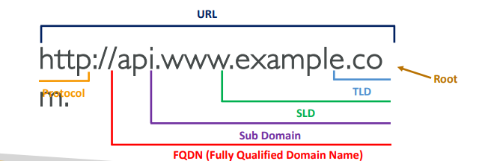
DNS Terminologies
• Domain Registrar: Amazon Route 53, GoDaddy, …
• DNS Records: A, AAAA, CNAME, NS, …
• Zone File: contains DNS records
• Name Server: resolves DNS queries (Authoritative or Non-Authoritative)
• Top Level Domain (TLD): .com, .us, .in, .gov, .org, …
• Second Level Domain (SLD): amazon.com, google.com, …

Slide 5
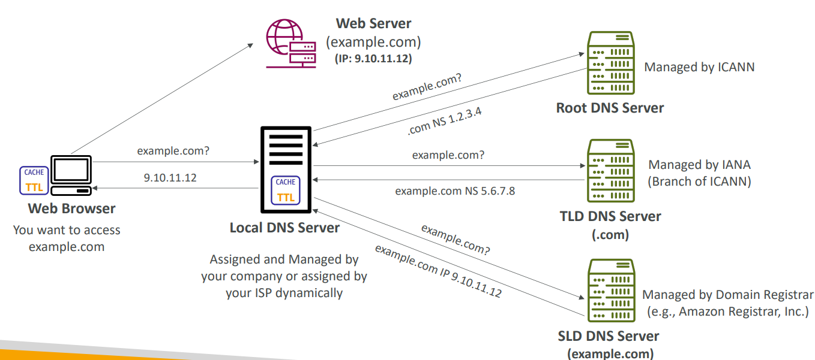
How DNS Works

Slide 6
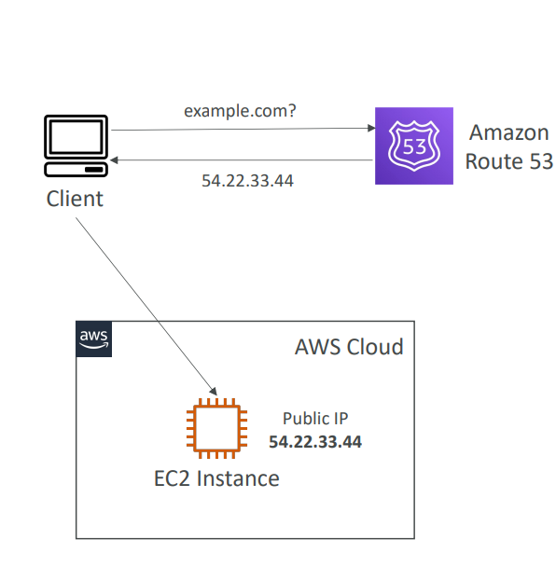
Amazon Route 53
• A highly available, scalable, fully
managed and Authoritative DNS
Authoritative = the customer (you)
can update the DNS records
• Route 53 is also a Domain Registrar
• Ability to check the health of your resources
• The only AWS service which provides 100% availability SLA
• Why Route 53? 53 is a reference to the traditional DNS port

Slide 7
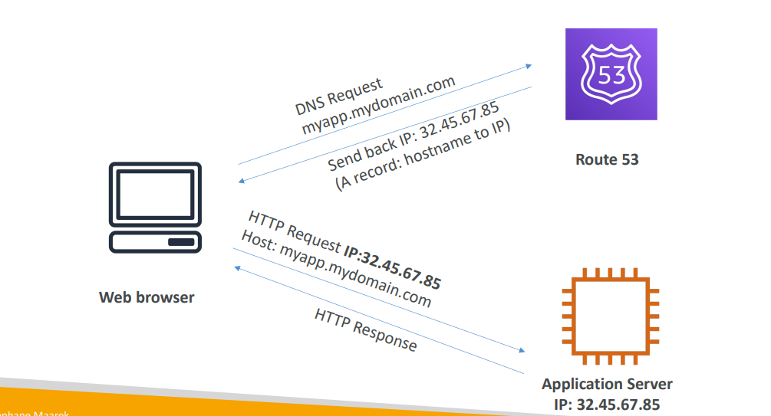
Route 53 – Diagram for A Record

Slide 8
Route 53 – Record Types
• A – maps a hostname to IPv4
• AAAA – maps a hostname to IPv6
• CNAME – maps a hostname to another hostname
The target is a domain name which must have an A or AAAA record
Can’t create a CNAME record for the top node of a DNS namespace (Zone Apex)
Example: you can’t create for example.com, but you can create for www.example.com
• NS – Name Servers for the Hosted Zone
Control how traffic is routed for a domain

Slide 9
Route 53 – Hosted Zones
• A container for records that define how to route traffic to a domain and its subdomains
• Public Hosted Zones – contains records that specify how to route
traffic on the Internet (public domain names)
application1.mypublicdomain.com
• Private Hosted Zones – contain records that specify how you route
traffic within one or more VPCs (private domain names)
application1.company.internal
• You pay $0.50 per month per hosted zone

Slide 10
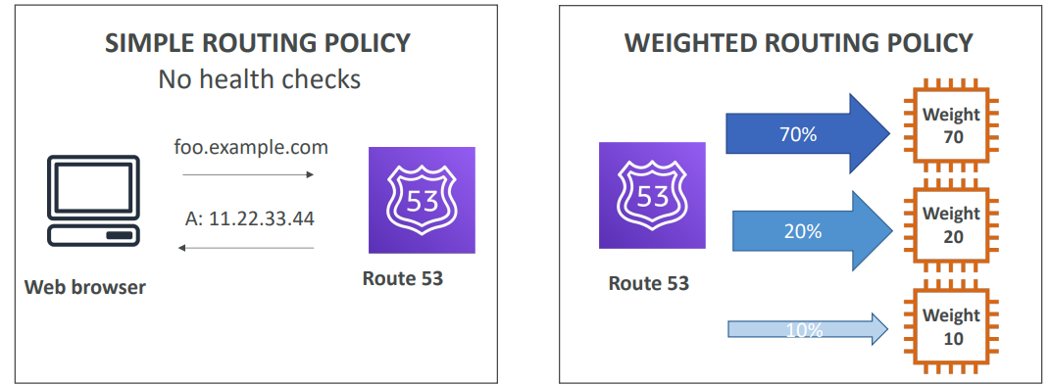
Route 53 Routing Policies

Slide 11
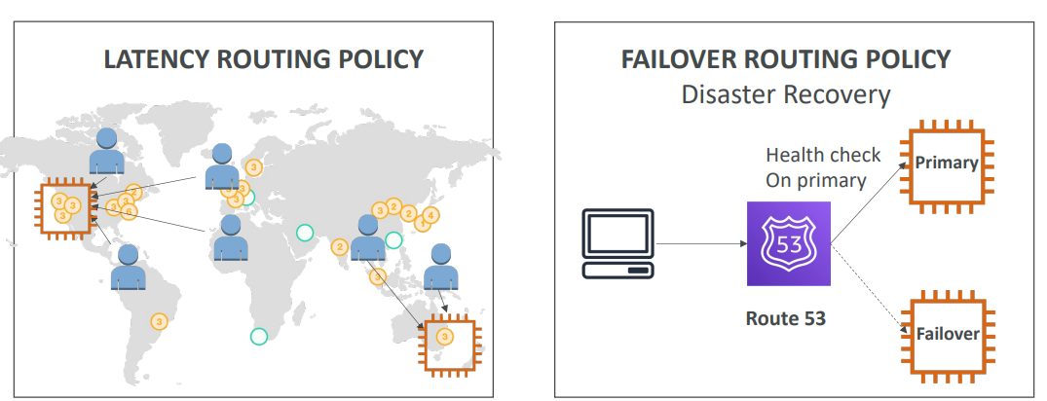
Route 53 Routing Policies

Slide 12
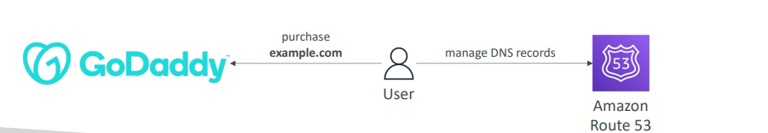
Domain Registar vs. DNS Service
• You buy or register your domain name with a Domain Registrar typically by
paying annual charges (e.g., GoDaddy, Amazon Registrar Inc., …)
• The Domain Registrar usually provides you with a DNS service to manage
your DNS records
• But you can use another DNS service to manage your DNS records
• Example: purchase the domain from GoDaddy and use Route 53 to manage
your DNS records

Slide 13
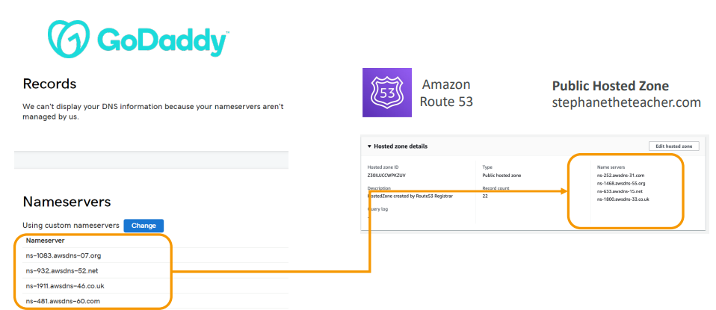
GoDaddy as Registrar & Route 53 as DNS Service

Slide 14
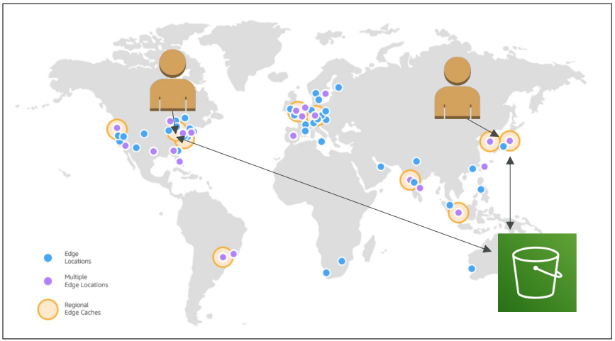
Amazon CloudFront
• Content Delivery Network (CDN)
• Improves read performance,
content is cached at the edge
• Improves users experience
• 216 Point of Presence globally (edge
locations)
• DDoS protection (because
worldwide), integration with Shield,
AWS Web Application Firewall Source: https://aws.amazon.com/cloudfront/features/?nc=sn&loc=2

Slide 15
CloudFront – Origins
• S3 bucket
For distributing files and caching them at the edge
Enhanced security with CloudFront Origin Access Control (OAC)
OAC is replacing Origin Access Identity (OAI)
CloudFront can be used as an ingress (to upload files to S3)
• Custom Origin (HTTP)
Application Load Balancer
EC2 instance
S3 website (must first enable the bucket as a static S3 website)
Any HTTP backend you want

Slide 16
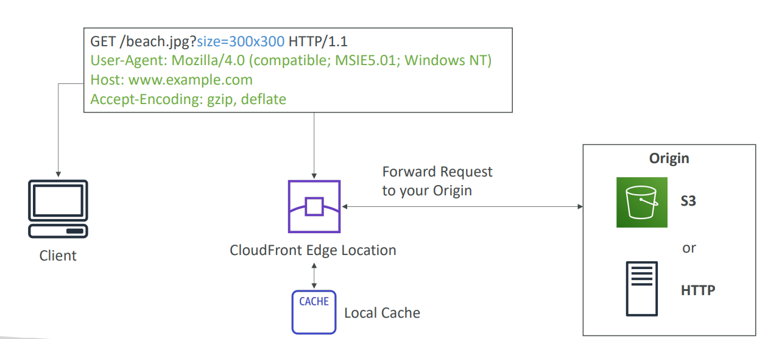
CloudFront at a high level

Slide 17
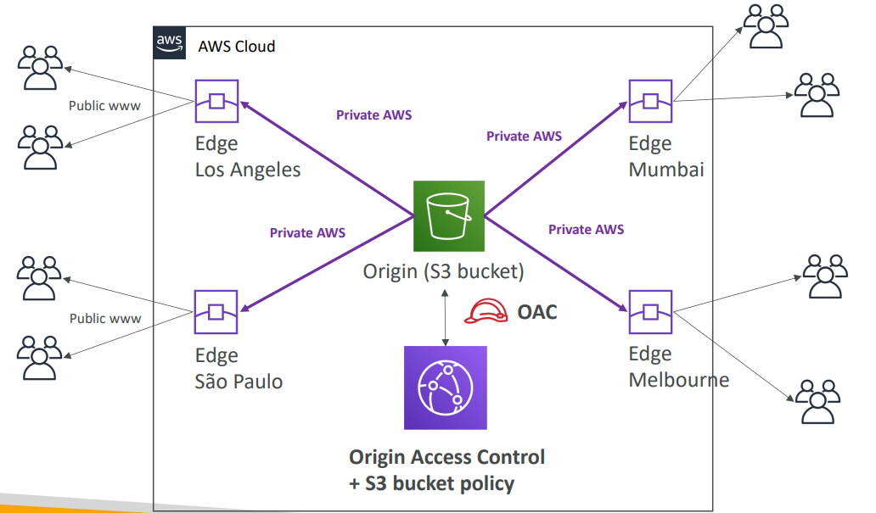
CloudFront – S3 as an Origin

Slide 18
CloudFront Geo Restriction
• You can restrict w ho can access your distribution
Allowlist: Allow your users to access your content only if they're in one of the
countries on a list of approved countries.
Blocklist: Prevent your users from accessing your content if they're in one of the
countries on a list of banned countries.
• The “country” is determined using a 3rd party Geo-IP database
• Use case: Copyright Laws to control access to content

Slide 19
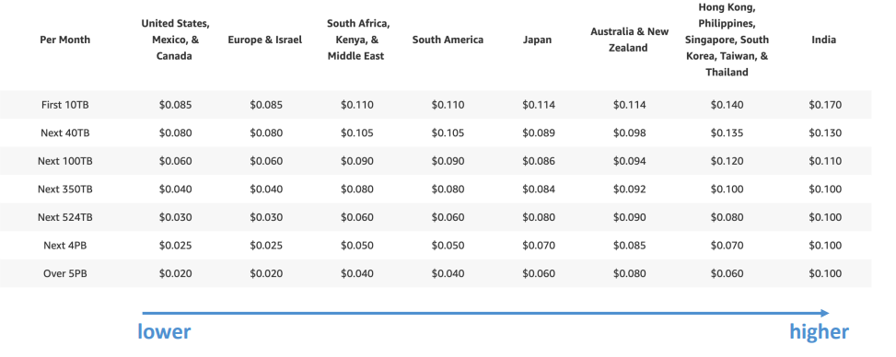
CloudFront - Pricing
• CloudFront Edge locations are all around the world
• The cost of data out per edge location varies

